Slide 1

CANADIAN GOVERNMENT INTERVENTION IN ENSURING CRITICAL INFRASTRUCTURE PROTECTION.
Josephine Famiyeh 40262544
Anita Francis Archibong 27729790
Rahul Hulli 40234542

Slide 2
PRESENTATION STRUCTURE
Classification of Critical Infrastructure
Threat sources to the Critical Infrastructure
Role of Canadian government in ensuring protection of critical infrastructure
Solution in place which tackle these threat
Protection mechanisms of critical infrastructure in the US in comparison with that of Canada
Comprehensive approaches for government to boost the security of critical infrastructure

Slide 3
CANADIAN GOVERNMENT INTERVENTION IN ENSURING CRITICAL INFRASTRUCTURE PROTECTION
Critical infrastructure encompasses processes, systems, facilities, technologies, networks, assets, and services crucial for Canadians' well-being, health, safety, security, and economic prosperity and for the efficient functioning of the government.
Critical infrastructure may stand independently or be interconnected and interdependent, spanning provinces, territories, and national boundaries.
The destruction, disruption, or damage to critical infrastructure due to terrorism, criminal acts, or other malicious activities could result in severe loss of life, adverse economic impacts, and negatively affect the country's security and the well-being of its inhabitants.

Slide 4
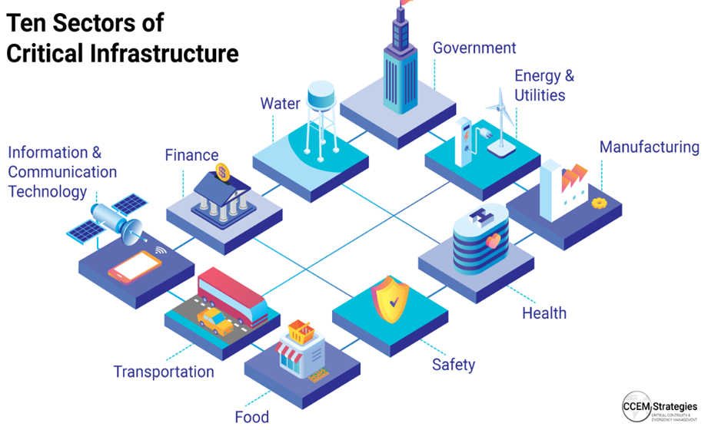
CLASSIFICATION OF CANADA’S CRITICAL INFRASTRUCTURE
At the national level, Canada's National Strategy for Critical Infrastructure categorizes critical infrastructure into

Slide 5
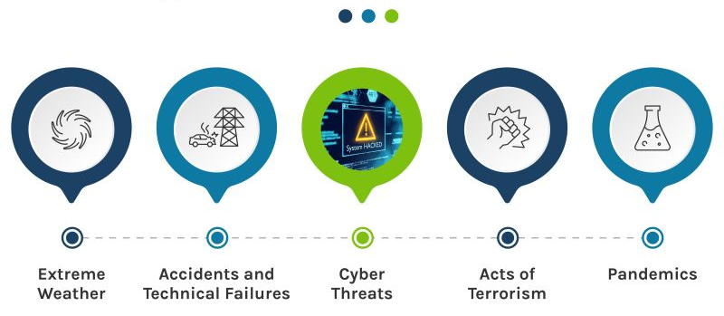
THREAT SOURCES TO CRITICAL INFRASTRUCTURE

Slide 6

THE ROLE OF THE CANADIAN GOVERNMENT
The Primary role is management and Leadership.
The Canadian government has put forth two (2) key initiatives to safeguard its essential national infrastructures:
National Strategy for Critical Infrastructure
National Cyber Security Strategy

Slide 7
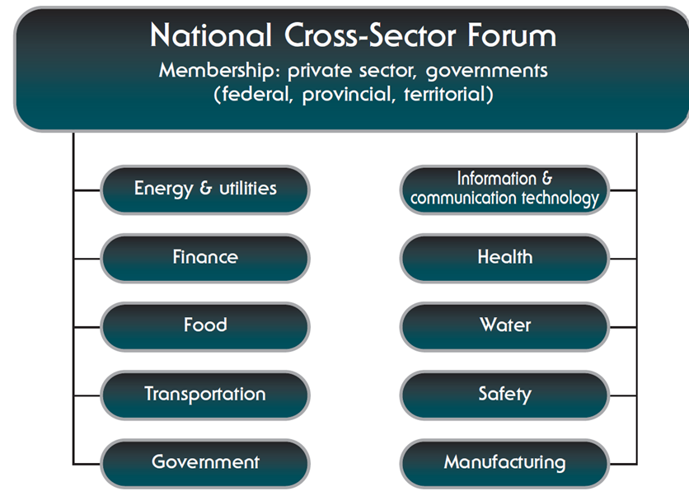
NATIONAL STRATEGY FOR CRITICAL INFRASTRUCTURE
The Aim
Improve the resilience of Canada's critical infrastructure.
This strategy was formulated based on three key principles:
1. Establish partnerships
Foster collaboration among federal, provincial, territorial, and critical infrastructure sectors.
2. Implement an all-hazard risk management approach
Understand the risks confronting the partners and conduct comprehensive all-hazard risk analyses.
3. Share and protect information
Facilitate secure and timely exchange of actionable risk information and monitor the status of critical assets.
.

Slide 8
NATIONAL STRATEGY FOR CYBERSECURITY
CYBER SECURITY FRAMEWORKS AND STANDARDS
Canada has adopted various cybersecurity frameworks and standards to guide organizations in securing their systems and data.
GOVERNMENT AGENCIES
Several government agencies are responsible for cybersecurity initiatives. These agencies collaborate to monitor threats, provide guidance, and respond to cyber incidents.
The aim of Canada's cybersecurity strategy is multifaceted, aiming to protect Canada's digital infrastructure, enhance national security, and promote economic prosperity in the digital age.
The outline of the strategy and approach encompasses a range of policies, initiatives, and partnerships aimed at enhancing cybersecurity resilience across the country such as cyber security frameworks, public-private partnerships, government agencies and investments in development.
PUBLIC-PRIVATE PARTNERSHIPS
Public-private partnerships facilitate information sharing, cybersecurity awareness campaigns, and joint initiatives to strengthen defenses against cyber threats.
INVESTMENTS IN RESEARCH AND DEVELOPMENT
The Canadian government invests in cybersecurity research and development to foster innovation and develop cutting-edge technologies for cyber defense.
.

Slide 9
THE NEW CYBER SECURITY STRATERGY (JUNE 2018)
Security and Resilience
Improve cyber security across all federal agencies
Strengthen law enforcement capacity
Strengthen its investigative capacity
Cyber Innovation
Funding advanced cyber research
Encouraging digital innovation
Developing cyber skills and knowledge
Leadership and Collaboration
Take a leadership role and work with partners
Single point of contact
Reenergize awareness and engagement.
GOALS

Slide 10
SECURITY BUDGET INVESTMENTS
$244M
$60M
$508M
$109M
1st Strategy
5 years
1st Strategy
Annually subsequent years
2nd Strategy
5 years
1st Strategy
Annually subsequent years

Slide 11
AWARENESS SERIES FOR PROTECTING OPERATIONAL TECHNOLOGY (OT) (ITSAP.00.051)
Intro
Cyber physical systems and Industrial control system.
Created in July 2022 by Canadian Center for Cyber Security
Educate operators of CI on risks of OT and security measures
Protection
Monitoring and logging
Updating and patching
Isolating system processes
least privilege
Remediation
Evaluate the impact
Identify the attack
Isolate systems
Repair
Scan
Report to CCCS and RCMP depending on the severity of incident.
Threats
Remote access
Ransomware
Malware
DoS
Outdated systems.
Unpatched Software

Slide 12
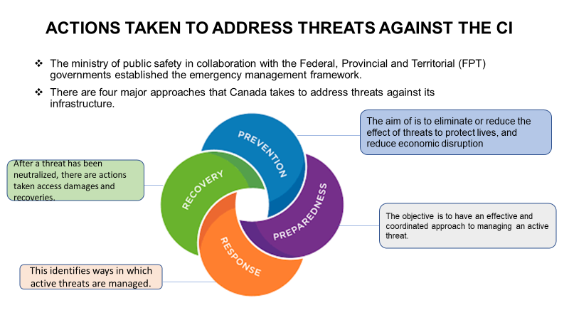
ACTIONS TAKEN TO ADDRESS THREATS AGAINST CRITICAL INFRASTRUCTURE

Slide 13
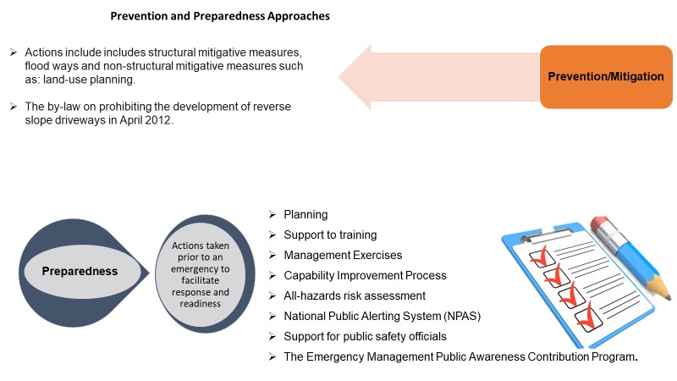
PREVENTION AND PREPAREDNESS APPROACHES

Slide 14
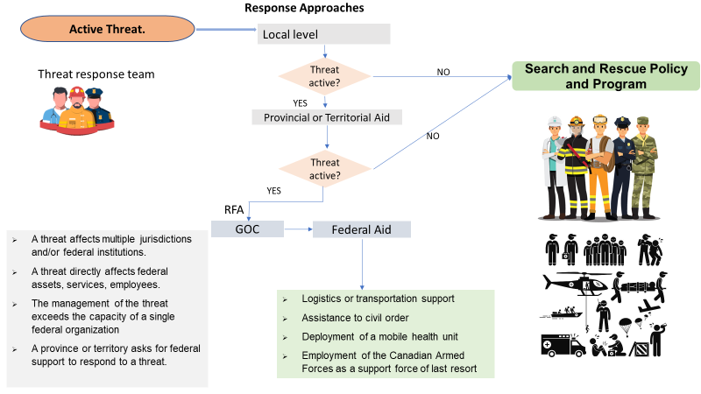
RESPONSE APPROACHES

Slide 15
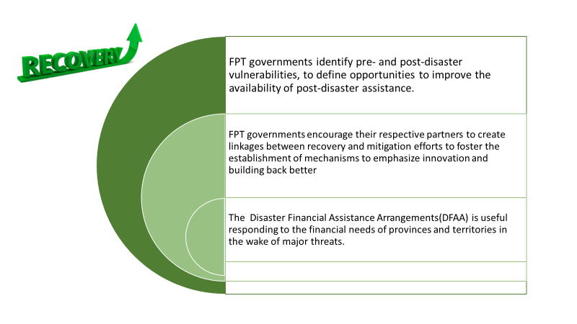
RECOVERY APPROACHES

Slide 16
RESPONSE TO CYBER THREATS ON CRITICAL INFRASTRUCTURE
CANADIAN CENTER FOR CYBERSECURITY
Be a single point of contact for individuals to report cybercrime online.
Coordinate cybercrime investigations in Canada.
Provide cybercrime intelligence for the Canadian Police.
Provide investigative advice and guidance to Canadian Police.
The NC3 work with partners internationally to combats wide range of cybercrime
Conduct cyber security assessments to help organizations identify vulnerabilities in their systems.
Provide Cl operators information on the latest threats affecting Cl systems.
Coordinate and deliver cyber-based exercises for the Cl community to test their resilience.
Offer technical training to mitigate cyber threats and strengthen resilience
Improved integrated threat assessment.
Enhance partnerships with operators and owners of Cl in the finance and energy sector to enable mutual exchange of cyber security knowledge.
Acts as the source of support on cyber security operational matters for the government, CI owner's ant the public
NATIONAL CYBERCRIME UNIT (NC3)﻿
PUBLIC SAFETY CANADA

Slide 17
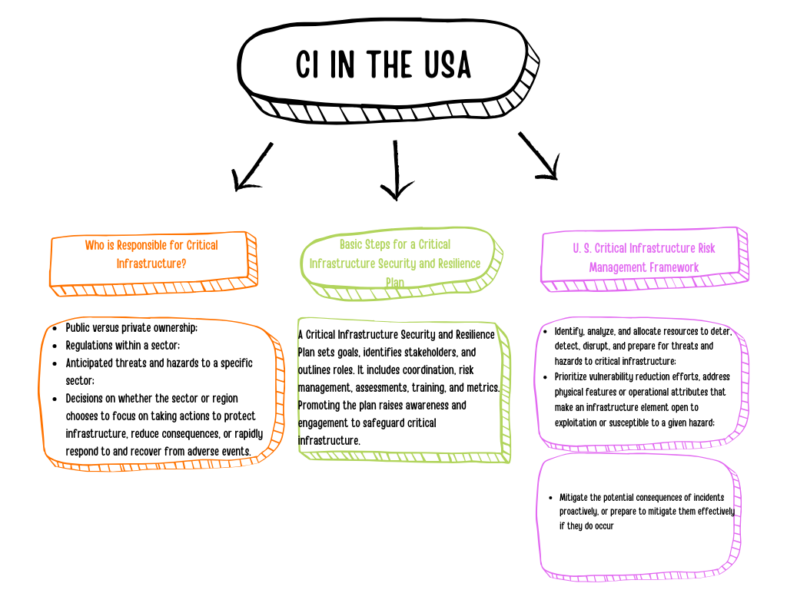

PROTECTION MECHANISMS OF CRITICAL INFRASTRUCTURE IN THE USA

Slide 18
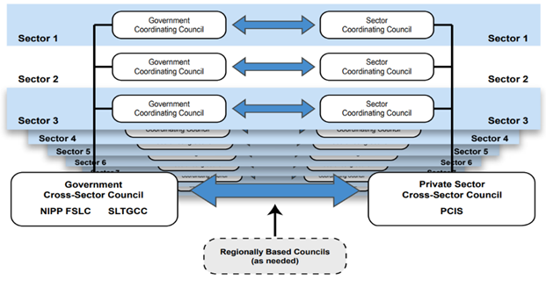
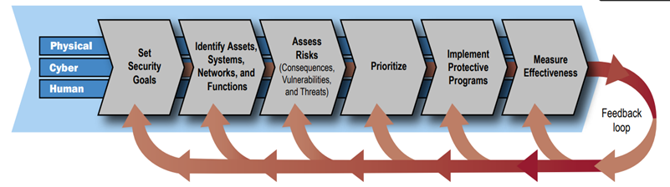
UNITED STATES INITIATIVES FOR PROTECTION OF CRITICAL INFRASTRUCTURE

Slide 19
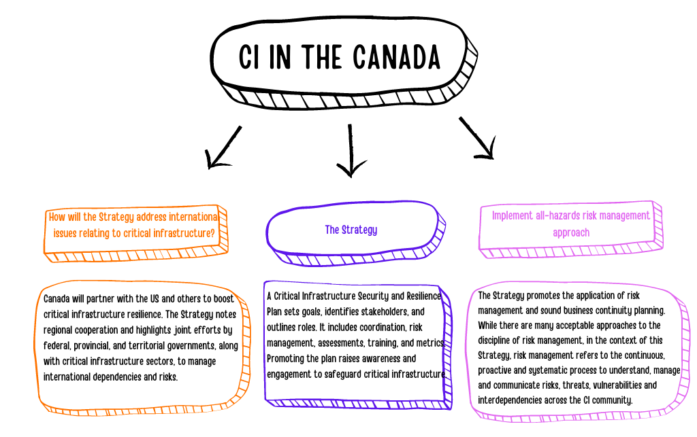
PROTECTION MECHANISMS OF CRITICAL INFRASTRUCTURE IN CANADA

Slide 20

CANADA INITIATIVES
In 2009, the federal government of Canada, in partnership with the provinces and territories, produced an Action Plan and National Strategy for CI.
Forging new coalitions to help and enhance the disaster resilience of critical infrastructure.

Slide 21
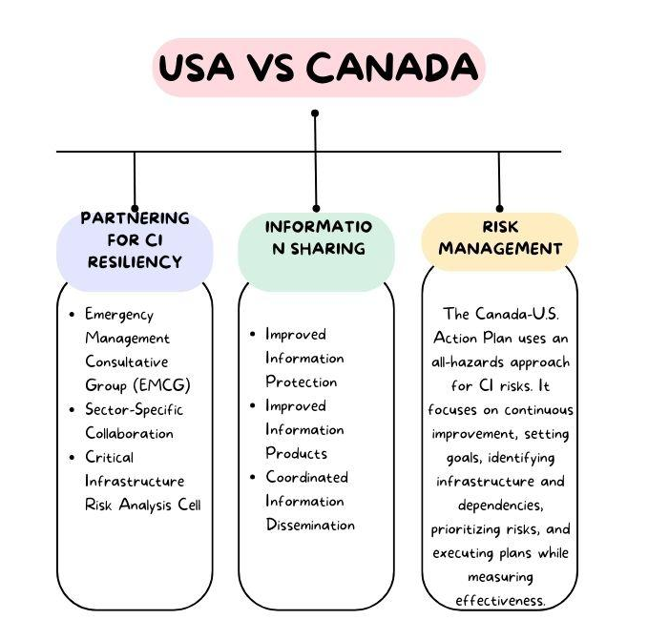
PROTECTION MECHANISMS OF CRITICAL INFRASTRUCTURE IN THE US IN COMPARISON TO CANADA

Slide 22

CANADA AND USA PARTNERSHIP
The two governments have been taking some of the required steps to mitigate the potential failure of critical infrastructure (CI). The Canada-United States Action Plan for Critical Infrastructure ("CUSCI") and the Beyond the Border Action Plan ("BTBAP") have always been voiced or prioritized by top officials in either nation because they have set of timelines, objectives, and accountability towards protecting cross border infrastructure and inland CI.

Slide 23

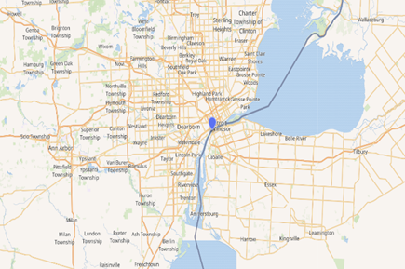
THE AMBASSADOR BRIDGE
There are 21 bridges or tunnels that make up the border of both countries some of which are tolled.
The agencies currently responsible for facilitating legal passage and ensuring its protection are the Canada Border Services Agency (CBSA) and U.S. Customs and Border Protection (CBP).

Slide 24
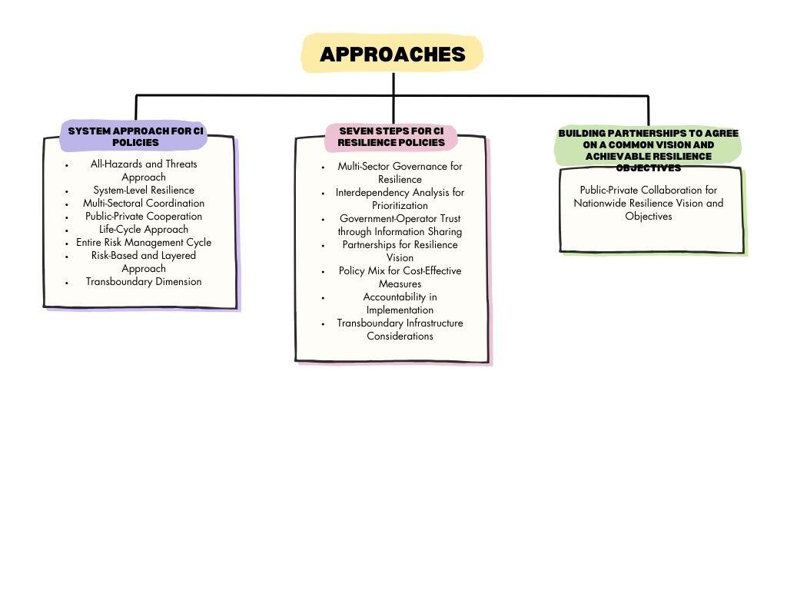
APPROACHES FOR CANADIAN GOVERNMENT TO BOOST THE SECURITY OF CRITICAL INFRASTRUCTURE
In this final section we will be presenting approaches to bolster the solutions which are already in place to maximize security of Canada’s critical infrastructure.
Policies
Enhance & expand Canada’s crisis management system to guarantee its internal integrity and cohesiveness.

Slide 25
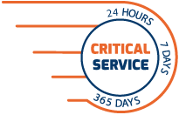

APPROACHES FOR CANADIAN GOVERNMENT TO BOOST THE SECURITY OF CRITICAL INFRASTRUCTURE
Identify and prioritise critical services/processes as opposed to critical sectors.
Fostering mutual dependencies through inter-sectoral networking,
to stimulate further cooperation between the various players.
Develop a CI protection framework which specifies the governmental agency that has
the overall coordination role in the definition & implementation of the national CIP strategy as well as ESF

Slide 26

APPROACHES FOR CANADIAN GOVERNMENT TO BOOST THE SECURITY OF CRITICAL INFRASTRUCTURE
Cybersecurity
Increase the volume, timeliness and quality of cyber threat information sharing
Public sector cyber teams will need to compete for talent with the private sector in their arenas
Enforce the practice of security assessments & penetration testing, product testing
Partner with academia and industry to expand cyber education for Canadian government employees
Develop a situational awareness capability that addresses both physical and cyber aspects of how infrastructure is functioning in (near) RT

Slide 27

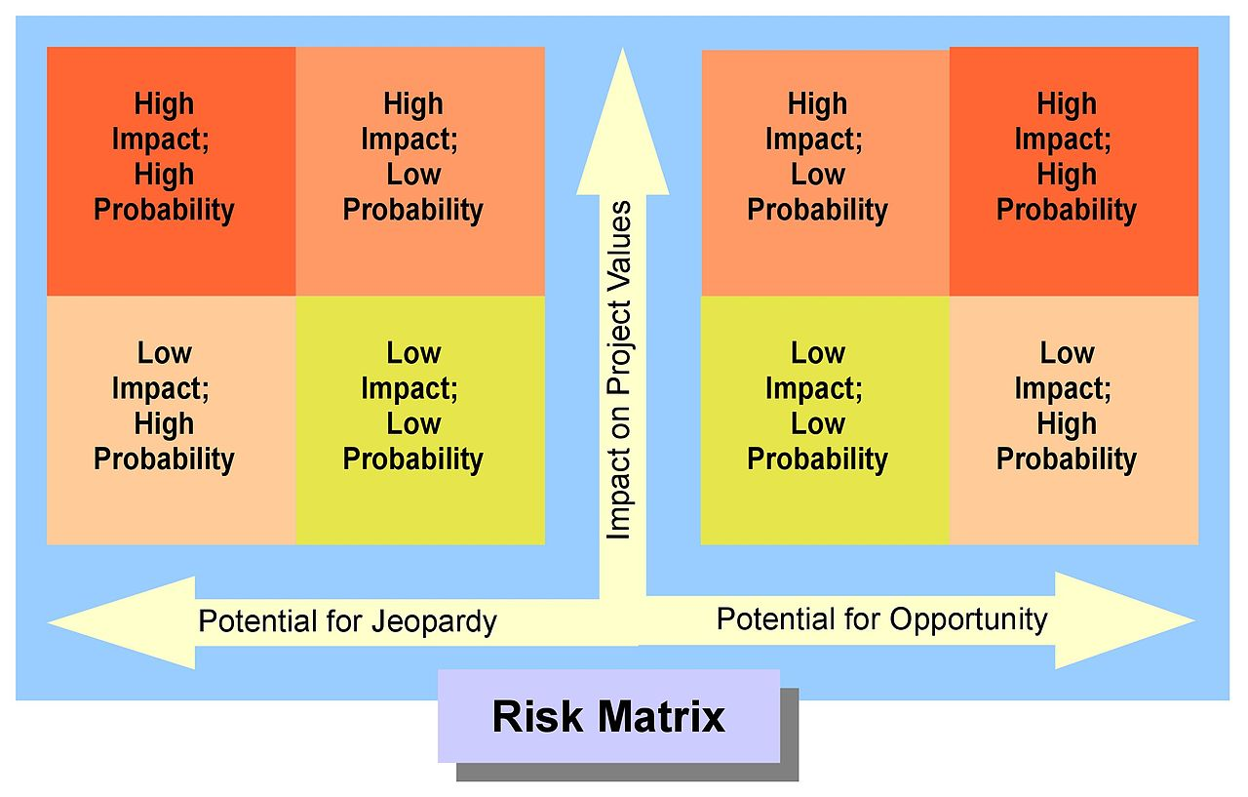
APPROACHES FOR CANADIAN GOVERNMENT TO BOOST THE SECURITY OF CRITICAL INFRASTRUCTURE
Protection of Cyber-physical Systems
Develop a CPS security strategy employing a holistic approach
Risk modelling for C-CPS
Build smart resilience in CPS

Slide 28
APPROACHES FOR CANADIAN GOVERNMENT TO BOOST THE SECURITY OF CRITICAL INFRASTRUCTURE
Identify and fill gaps in capabilities
OT, IoT, industrial IoT and IT security should be managed in a coordinated effort, not in isolation.
Invest in threat intelligence
Strategy
Collect & process all assets, users, software, network and other risk and threat data into a common DB where skilled resources can analyze data
Develop security validation tools to improve the efficacy of Security-by-Design.
Conduct continuous impact analysis & analysis of probabilities
Risk Modelling
Smart Resilience
Build systems that learn, repair & adapt themselves for threat/attack detection & prevention.
Develop tactics of how to remediate gaps & respond to threats
Invest in talent who oversee & intervene in R-T to security incidents to CPS

Slide 29
THANK YOU!

